Slide 1
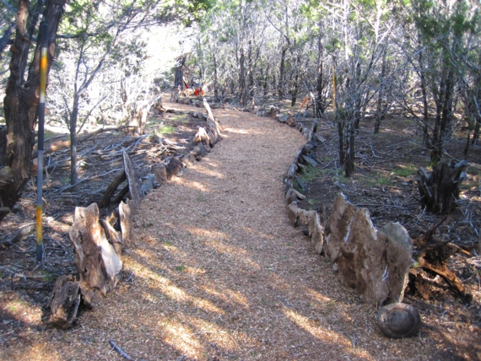
Rev. Kendall Waller
Director of Financial & Administrative Ministries
Rio Texas Conference
Building a Vision for Ministry

Slide 2
Devotion: Ephesians 3:7-10
⁷⁻⁸This is my life work: helping people understand and respond to this Message. It came as a sheer gift to me, a real surprise, God handling all the details. When it came to presenting the Message to people who had no background in God's way, I was the least qualified of any of the available Christians. God saw to it that I was equipped, but you can be sure that it had nothing to do with my natural abilities.

Slide 3
Devotion: Ephesians 3:7-10
⁸⁻¹⁰And so here I am, preaching and writing about things that are way over my head, the inexhaustible riches and generosity of Christ. My task is to bring out in the open and make plain what God, who created all this in the first place, has been doing in secret and behind the scenes all along. Through followers of Jesus like yourselves gathered in churches, this extraordinary plan of God is becoming known and talked about even among the angels!

Slide 4
God doesn’t care whether your church grows or dies.

Slide 5
God doesn’t care whether there is a United Methodist Church in your town or not.

Slide 6
God does care that the gospel is being proclaimed and people’s needs are being met.

Slide 7
Our Mission
“The mission of the Church is to make disciples of Jesus Christ for the transformation of the world."

Slide 8
Leaders Cast Vision
“Vision is a picture of a preferred future.”
Lovett Weems

Slide 9
Where are we and how did we get here?

Slide 10
What did you hear? What does it mean?

Slide 11
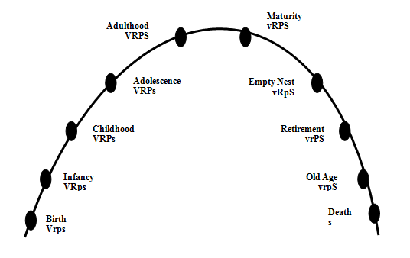
Church LifeCycle
V = Vision Where are we going?
R = Relationship Who is going with us?
P = Program How do we get there?
S = Structure
What do we control?

Slide 12
Where are we now?

Slide 13
What’s the best thing about your church?

Slide 14
What about your relationship
with Jesus
do other people need to hear?

Slide 15
Leaders Cast Vision
“Vision is a picture of a preferred future.”
Lovett Weems

Slide 16
What if?

Slide 17
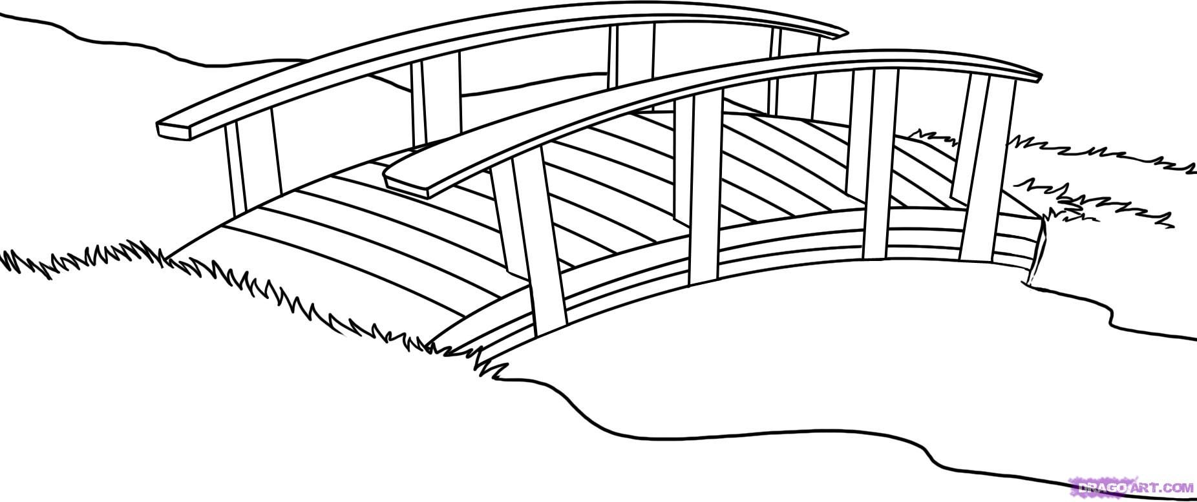
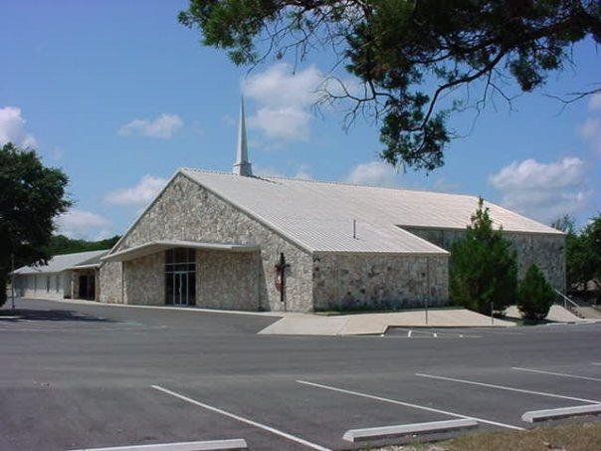
Here is where
we want to be…
Here is where
we are...

Slide 18
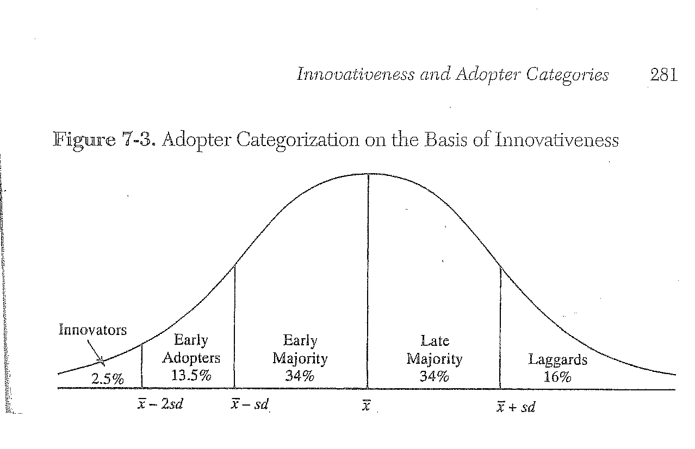
Diffusion of Innovations Everett M. Rogers

Slide 19
Building a Team
Get to know “MA” and “PA”
Identify Early Adopters
Identify decision making structures
Communication structures
Keep the District Superintendent in the loop

Slide 20
Who is the mission field?

Slide 21
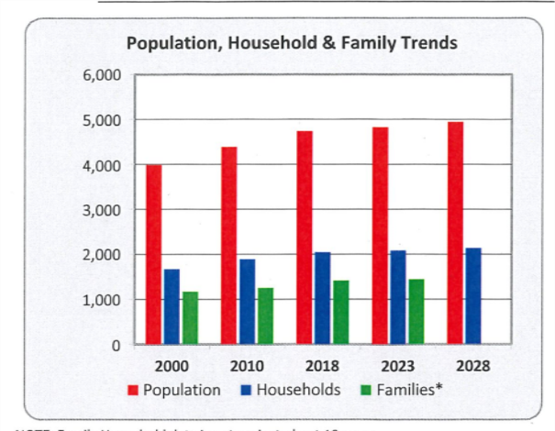

Slide 29
Who is the mission field?

Slide 30
Silent Reflection

Slide 31
What did you hear? What does it mean?

Slide 32
Sadly…
80% of all American UMC churches are stagnant or declining
Only 20% are growing
Less than 1% grow from new professions of faith
19% of the growing churches grow by transfers

Slide 33
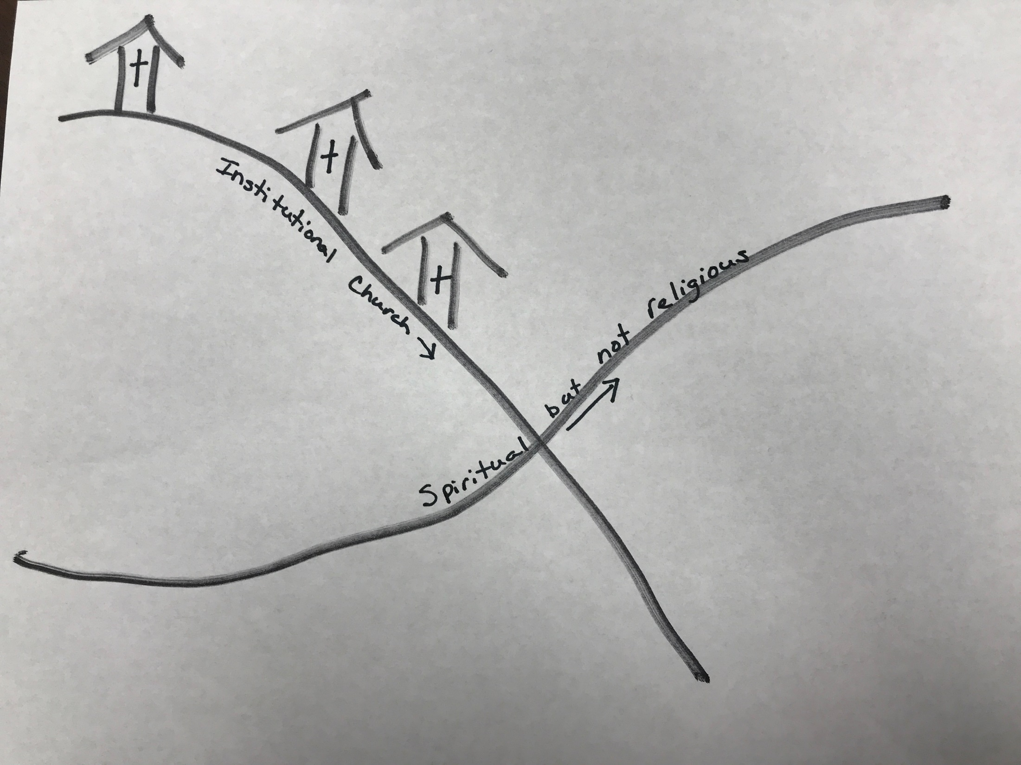

Slide 34
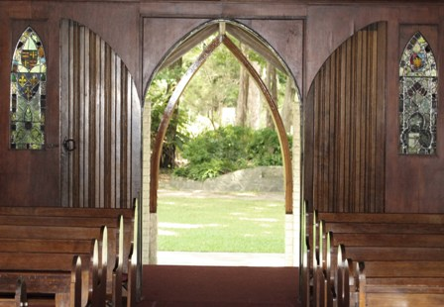

Slide 35
What are two of the best things your home church (or the pastor) does to get into the community and build relationships (not just “one and done” mission work)?
10 minutes

Slide 36
What are two of the best things your home church (or the pastor) does to get into the community and build relationships (not just “one and done” mission work)?
As a group come up with five creative things a church could do to reach out to the community to build relationships…YOU CANNOT NAME THINGS ANYONE IN THE GROUP IS ALREADY DOING!
10 minutes

Slide 37
Notes:
Mission is what we do. This should be the same in all churches. Some may say it in different words, but the results must be the same.

Slide 38
Building a Strategic Plan
Who’s going to do it?
When will we have
it done?

Slide 39
When we aim at nothing in particular, that’s what we hit.
Notes:
Unfortunately, this is what happens in too many churches. We have good intentions, we have LOTS of meetings, our calendars are FULL of activities…but at the end of the year we are no closer to our vision than we were at the beginning of the year. (That may be because we did not even know what the vision was!)
It is of vital importance that we are all clear on what our mission and vision is so that we can develop goals as a church and in our specific ministry areas in order to ensure we achieve that vision.
Now that we understand the key concepts of Accountability Leadership, let’s look at how we can connect it to our mission, vision, and goals.

Slide 40
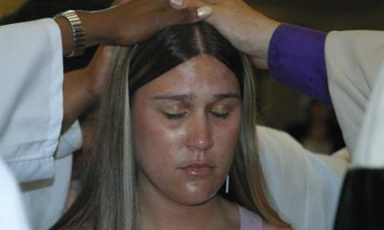
Mission
Our mission is making new disciples of Jesus Christ for the transformation of the world.
Everything flows from mission…
Notes:
Mission is what we do. This should be the same in all churches. Some may say it in different words, but the results must be the same.

Slide 41
Vision
The unique way a congregation achieves or accomplishes the mission.
The key ingredients of a vision statement need to be outwardly focused, measurable, and provides a framework for goals and accountability for the congregation and staff.
What % of the mission field are you going to reach for Jesus?
Notes:
The church should have already at least begun the process of developing their vision. Ask for someone to share it with the group.
It would be good to have the vision written on a flipchart page and hung in the room for everyone to see throughout the workshop.

Slide 42
New Leadership Agenda
Annually
Set goals
Set budget
Evaluate
Notes:
What do we need to do? What do we need to starve?

Slide 43
Church Wide Goals
Who?
When?
Where?
How?
Did it work?
Specific
Measurable
Achievable
Relevant
Time-Based
Notes:
Explain to the group the importance of a church having clear goals. More detailed information is available from Ken Willard if needed. (This is also covered as part of our PLD2 training in session one.)

Slide 44
New Leadership Agenda
1/3 – Spiritual Formation, Leadership Development, review of new people/families
1/3 – Review goals / Accountability and reallocation of assets
1/3 – Deal with pressing decisions/issues, help groups as needed, problem solving
Annually set goals and evaluate
Notes:
What do we need to do? What do we need to starve?

Slide 45
Typical Agenda for Simplified Structure with Accountable Leadership
Prayer
Spiritual Formation
Leadership Development
Review of New People
Review of Goals
Pressing Issues/Problem Solving
Approval & Questions from Packet
Communication
Prayer

Slide 46
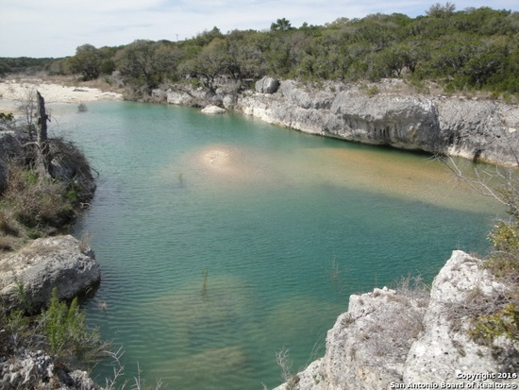
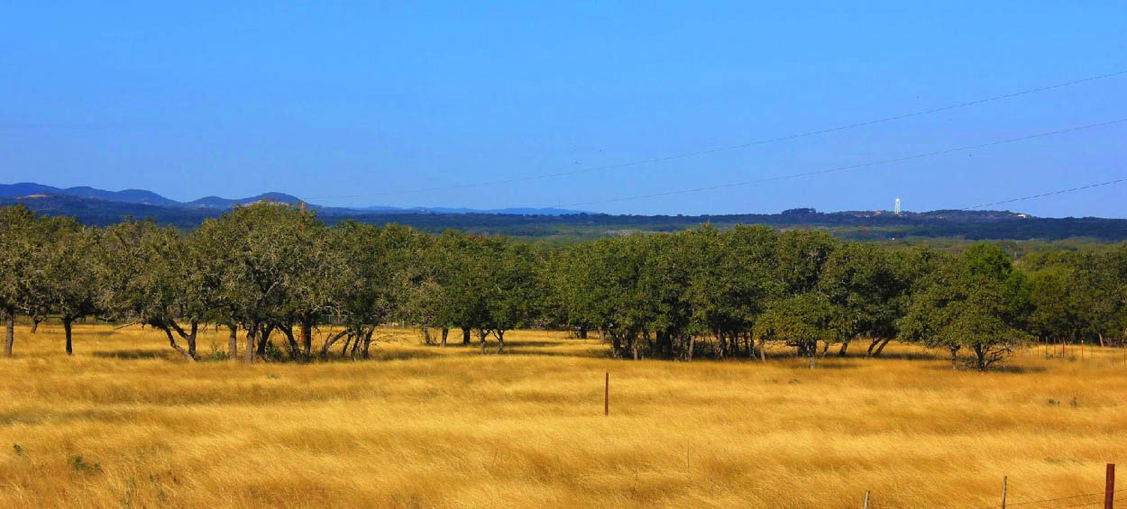
Questions?

